Slide 1
Baseball Project
Pitcher Model
By Ian Scarff

Slide 2
Goal
To develop a model to predict what type of pitch a pitcher might throw next.
This would give insight to batters allowing them to adjust their stance and swing.
To build model, the goal was to replicate game conditions.

Slide 3
Variables
Response:
  Pitch Types
    Fastball, Curveball, ChangeUp, Cutter, Sinker, Slider, and Splitter.
Predictors:
  Pitch number of the game.
  Pitch number of the inning.
  Pitch number for the current batter.
  Pitcher’s throwing arm.
  Batter’s batting arm.
  The number of innings.
  The number of outs.
  The number of balls.
  The number of strikes.
  Lag variables for each pitch type.
Specific batters, pitchers, and teams were not considered.
Teams change over time. Ignoring these features allows for a general model.

Slide 4
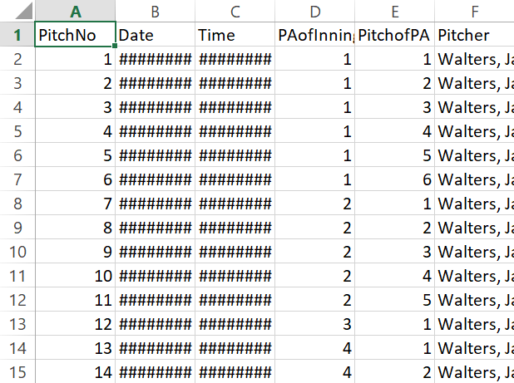
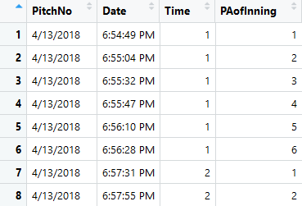
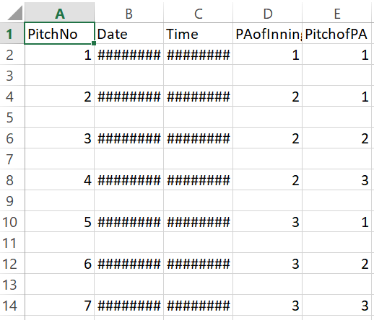
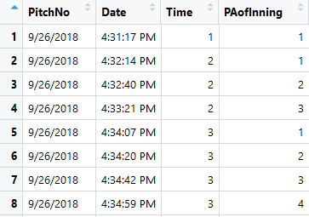
Data Preparation
Data set given was invalid.
Needed the original data files. (37 games)
Data files needed to be of a certain format.
Column entries are shifted to the left
Import .csv to R

Slide 5
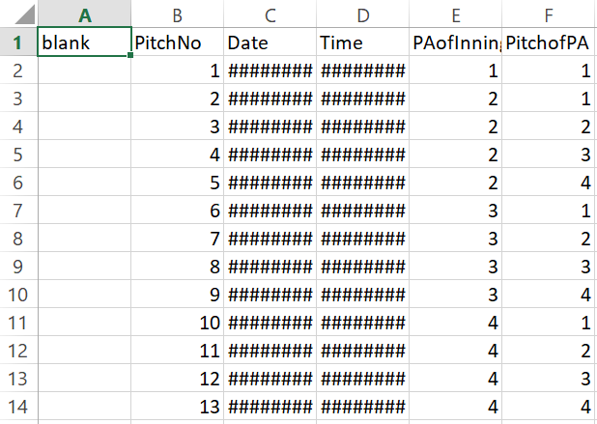
Data Preparation
In future, data files should be of this format.
The blank column fixes importing issues.

Slide 6
Algorithm
Import Training Data
If
Import Test Data
Accuracy
Set Parameters
If
Build Model
If
Predict

Slide 7
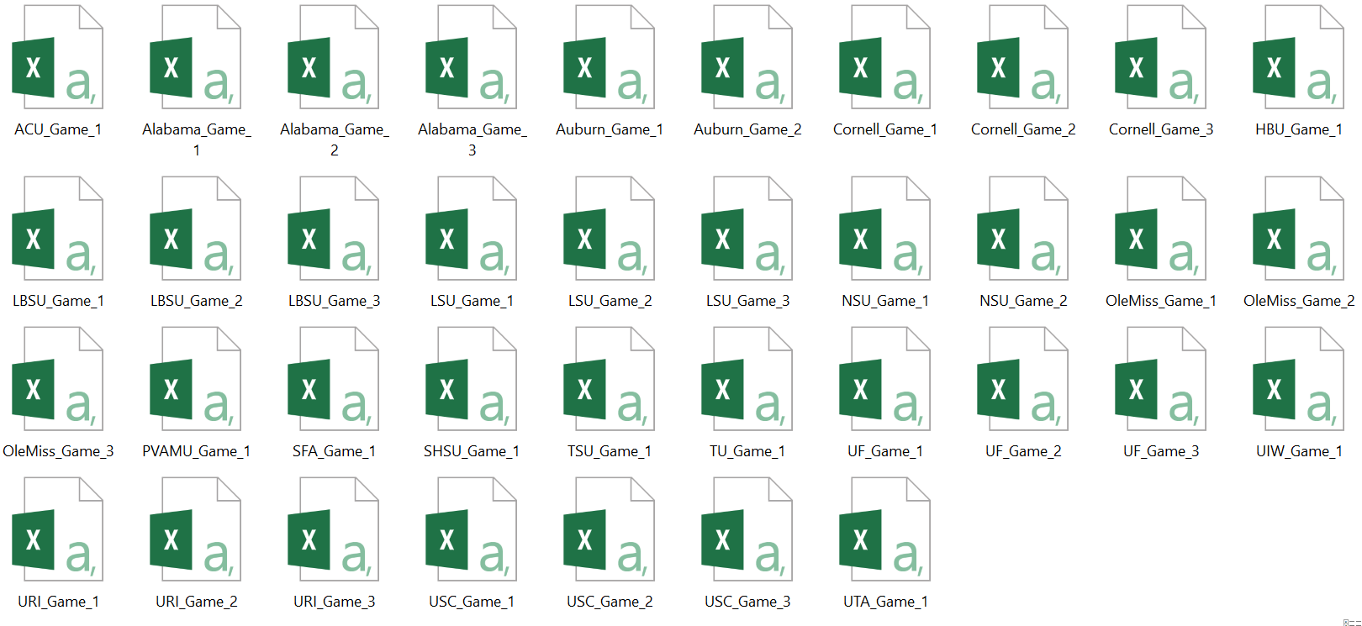
Import Training Data
Uses the working directory to load in all game files.
Assigns each game to individual data frames.

Slide 8
Algorithm
Import Training Data
If
Import Test Data
Accuracy
Set Parameters
If
Build Model
If
Predict

Slide 9
Parameters
Two global parameters are needed to build the model:
  The current pitch of the game.
  How many previous pitches to keep track of.
These are used to calculate the lag variables for each pitch type.

Slide 10
Algorithm
Import Training Data
If
Import Test Data
Accuracy
Set Parameters
If
Build Model
If
Predict

Slide 11
1st If Statement
This if statement will only build a model if:
  The parameters have been set.
  The current pitch number is greater than the amount of pitches to look back on.
This way you can’t skip ahead.
$$current Pitch >Lookback$$

Slide 12
Algorithm
Import Training Data
If
Import Test Data
Accuracy
Set Parameters
If
Build Model
If
Predict

Slide 13
Building the Model
Makes copies of each game containing only the variables of interest.
Calculates the lag variables for each pitch type in each game.
  Starts at the current pitch selected.
  Counts how many times a certain pitch happened in the last number of selected pitches.
Combines all games by row into a single data frame.
Removes any undefined values for pitch type, batter arm, and pitcher arm.
Uses the multinom function from the nnet package to fit a multinomial log-linear model via neural networks.
  This function iterates through many models and chooses the best one.

Slide 14
Algorithm
Import Training Data
If
Import Test Data
Accuracy
Set Parameters
If
Build Model
If
Predict

Slide 15
2nd If Statement
This if statement will only import the test data sets if:
  A model has been built.

Slide 16
Algorithm
Import Training Data
If
Import Test Data
Accuracy
Set Parameters
If
Build Model
If
Predict

Slide 17
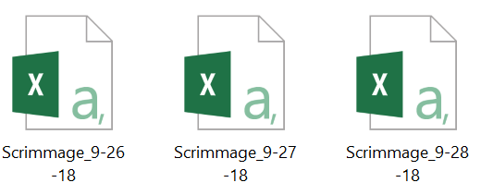
Importing Test Data
Takes in an input of a new working directory containing the test data.
For this project, the test data consisted of 3 scrimmage games.

Slide 18
Algorithm
Import Training Data
If
Import Test Data
Accuracy
Set Parameters
If
Build Model
If
Predict

Slide 19
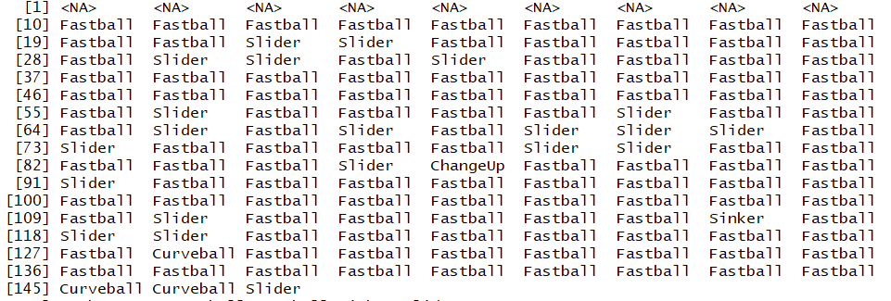
Predicting
Uses R’s built in predict function.
Makes predictions based off the built model using a test data set.
  Calculates the lag variables for the test data in the same way as the training data sets.
Example:
  Current pitch = 10
  Lookback = 5
  Data = Test1
    The 1st Scrimmage

Slide 20
Algorithm
Import Training Data
If
Import Test Data
Accuracy
Set Parameters
If
Build Model
If
Predict

Slide 21
3rd If Statement
This statement will only calculate the accuracy if:
  A prediction has been made.

Slide 22
Algorithm
Import Training Data
If
Import Test Data
Accuracy
Set Parameters
If
Build Model
If
Predict

Slide 23
Accuracy
Compares the prediction to the test data.
If the prediction is correct, a value of 1 is assigned. 0 otherwise.
The average of these gives a measurement of accuracy.
Example:
  Same setup
However, this measurement of accuracy isn’t the best.
Changing the original parameters changes the model, therefore, changing the prediction.

Slide 24
Algorithm
Import Training Data
If
Import Test Data
Accuracy
Set Parameters
If
Build Model
If
Predict
From there you can:
Import new data.
Make another prediction based different test data.
Set new parameters.

Slide 25
Follow-up Work
Allowing the user to chose how many pitches ahead to predict.
Testing other classification models.
  LDA, QDA, Random Forests, etc.
Eventual integration with the Shiny application.

Slide 26
Questions?

